Slide 1
4
Probability and Probability Distributions

Slide 2
Basic Terms
Probability is a numerical measure of chance of occurrence of event.
Any process which yields well defined results or statistical data is called an experiment. A result of experiment is called an outcome.
An experiment which has a unique(same)outcome,
when repeated under same conditions is a deterministic experiment.
Ex:Measuring the area of a circle of a specified(with fixed) radius.

Slide 3
Basic Terms
Probability theory is concerned only with analysis of random experiment.
Sample Space
The set of all possible outcomes of a random experiment is a sample space. It is denoted by ‘S’
A sample space containing only finite number of outcome is a finite sample space.
When a coin is tossed the S={H,T}
A sample space with uncountable number of outcome is an infinite sample space.
Body temperature may be between 98º F and 104º F

Slide 4
Basic Terms
Events
An event is a set of outcomes of a random experiment. It is a subset of sample space. Events are denoted by capital letters A,B,C etc and their outcomes are denoted by small letters a,b,c etc.
An event does not contain any outcome is null(impossible)event.
An event has only one outcome is a simple event.
An event has more than one outcome is a compound event.
Example: While throwing a die ,A is an event of getting a multiple of 3, B is an event of getting a multiple of 4, C is an event of getting a multiple of 7.
That is, A={3,6},B={4},C=ɸ

Slide 5
Introduction (slide 1 of 3)
A key aspect of solving real business problems is dealing appropriately with uncertainty.
This involves recognizing explicitly that uncertainty exists and using quantitative methods to model uncertainty.
In many situations, the uncertain quantity is a numerical quantity. In the language of probability, it is called a random variable.
A probability distribution lists all of the possible values of the random variable and their corresponding probabilities.

Slide 6
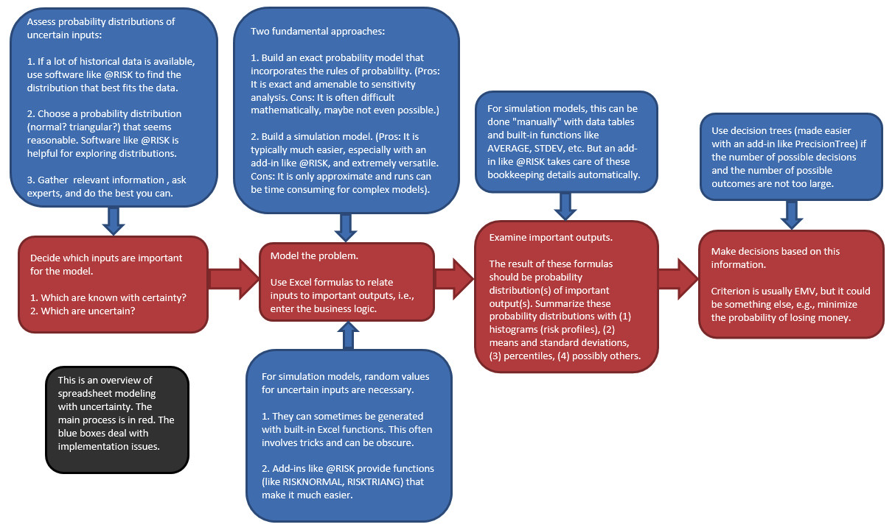
Flow Chart for Modeling Uncertainty

Slide 7
Introduction
Uncertainty and risk are sometimes used interchangeably, but they are not really the same.
You typically have no control over uncertainty; it is something that simply exists.
In contrast, risk depends on your position.
Even if something is uncertain, there is no risk if it makes no difference to you.

Slide 8
Probability Essentials
A probability is a number between 0 and 1 that measures the likelihood that some event will occur.
An event with probability 0 cannot occur, whereas an event with probability 1 is certain to occur.
An event with probability greater than 0 and less than 1 involves uncertainty, and the closer its probability is to 1, the more likely it is to occur.
Probabilities are sometimes expressed as percentages or odds, but these can be easily converted to probabilities on a 0-to-1 scale.

Slide 9
Example
Probability that Occurrence of head when we flip coin
We can write this as P(H)=1/2
The probability that a six will occur when an fair die is rolled should be P(6)=1/6
The probability that an ace of hearts will be drawn from an ordinary deck of cards is
P(ace of hearts )=1/52

Slide 10
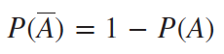
Rule of Complements
The simplest probability rule involves the complement of an event.
If A is any event, then the complement of A, denoted by A (or in some books by A^{c}), is the event that A does not occur.
If the probability of A is P(A), then the probability of its complement is given by the equation below.

Slide 11
Rule of Complements
Determining Complements of an Event
Let us refer back to the experiment of throwing one die. As you know, the sample space of a fair die is S={1,2,3,4,5,6}. If we define the event A as observing an odd number, then A={1,3,5}. The complement of A will be all the elements of the sample space that are not in A. Thus, A′={2,4,6}.
A Venn diagram that illustrates the relationship between A and A′ is shown below:

Slide 12
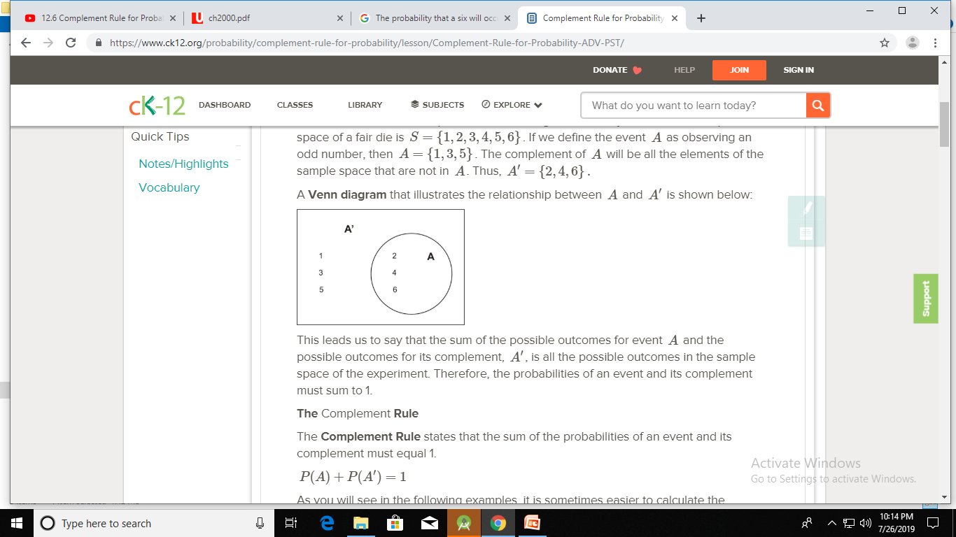
Rule of Complements
The Complement Rule states that the sum of the probabilities of an event and its complement must equal 1.
P(A)+P(A′)=1
Once this is done, the probability of the event, P(A′), is calculated using the relationship P(A′)=1−P(A).

Slide 13
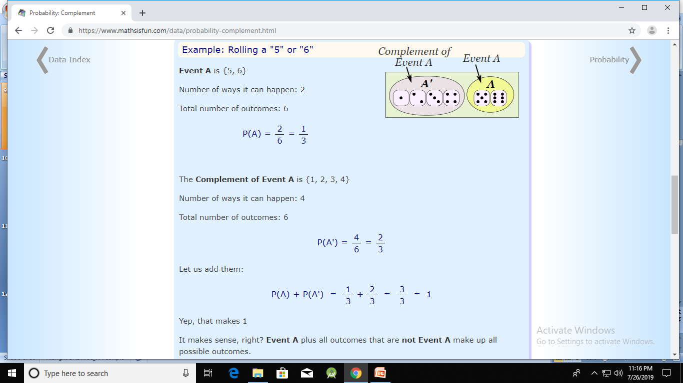
Rule of Complements

Slide 14
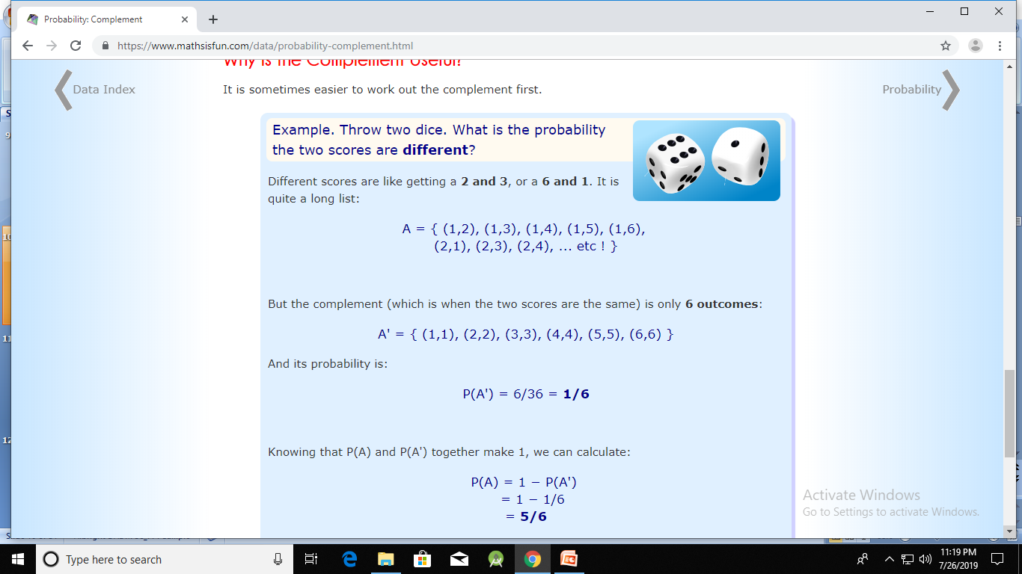
Why is the Complement Useful?

Slide 15
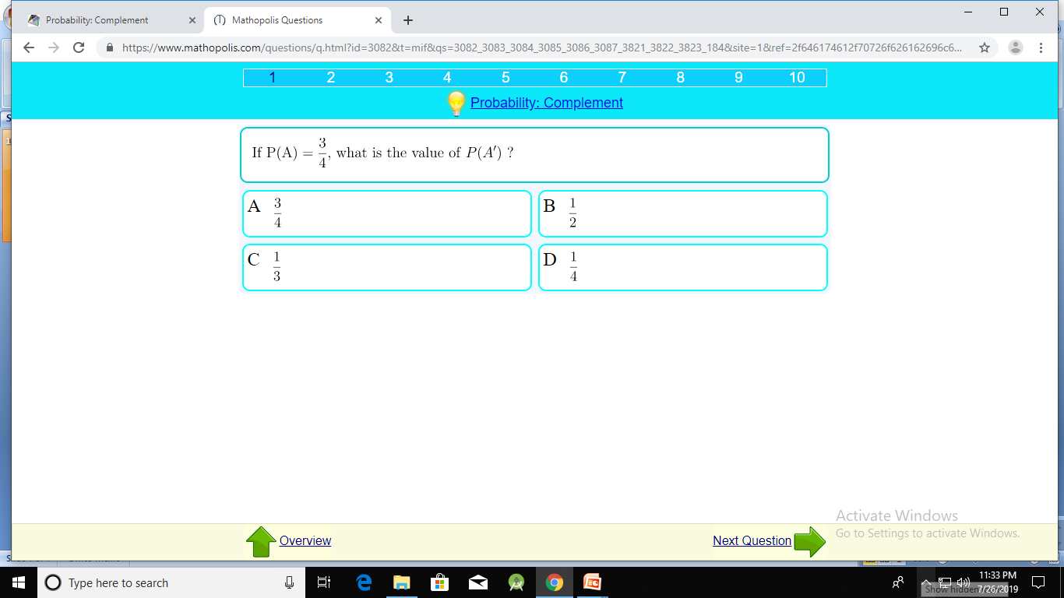

Slide 16
Solution:
Complement Rule
P(A′) = 1 − P(A)
= 1 − ¾
= 1/4

Slide 17
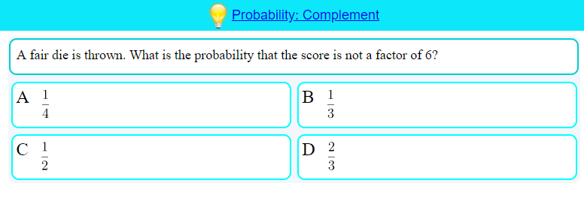

Slide 18
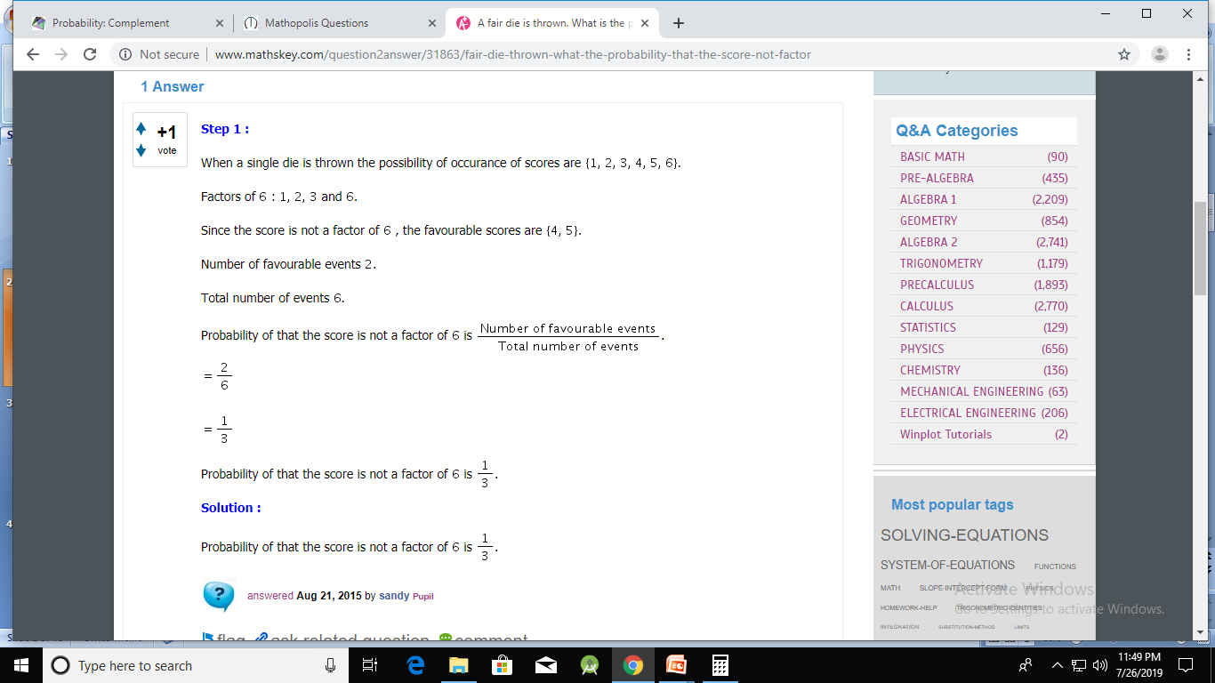

Slide 19


Slide 20
Solution
When two coins are tossed , then possible outcomes are : HH ; HT ; TT ; TH Total possible outcomes =4 The outcomes in which one or more head occurs are : ​HT ; HH ; TH No. of favorable outcomes =3 required probability = no. of favourable outcomes/ total outcomes = 3/4 =75%

Slide 21
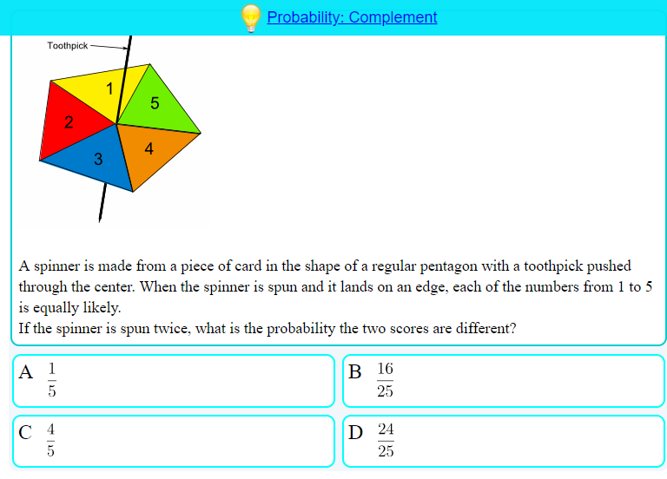

Slide 22
Solution:
P(A′) = {(1,1),(2,2),(3,3),(4,4),(5,5)}
P(A′) = 5/25=1/5
P(A) = 1 - P(A′)
= 1 – 1/5
=4/5

Slide 23
Addition Rule
Events are mutually exclusive if at most one of them can occur—that is, if one of them occurs, then none of the others can occur.
Events are exhaustive if they exhaust all possibilities—one of the events must occur.
The addition rule of probability involves the probability that at least one of the events will occur.
When the events are mutually exclusive, the probability that at least one of the events will occur is the sum of their individual probabilities:

Slide 24
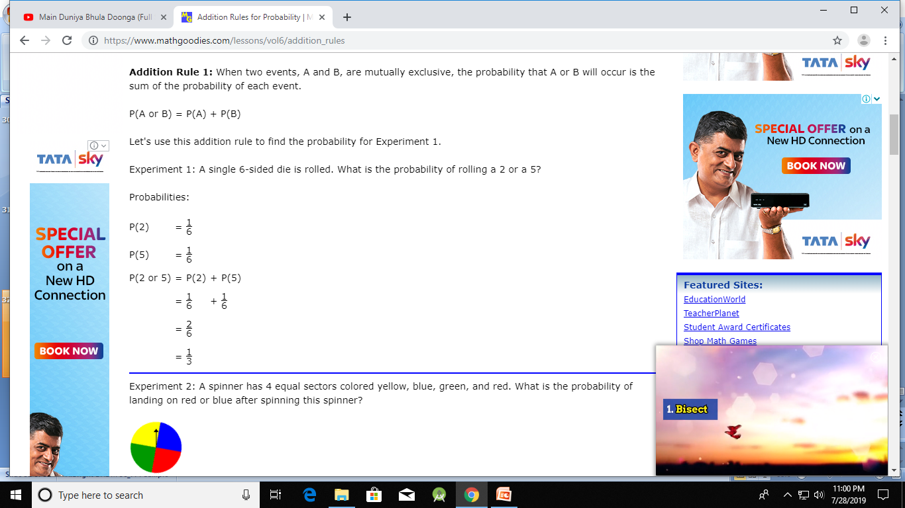
Addition Rule

Slide 25
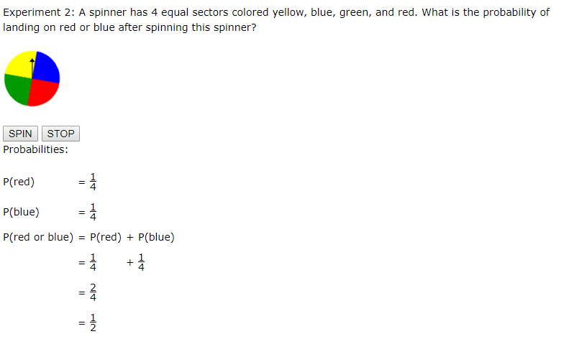
Addition Rule

Slide 26
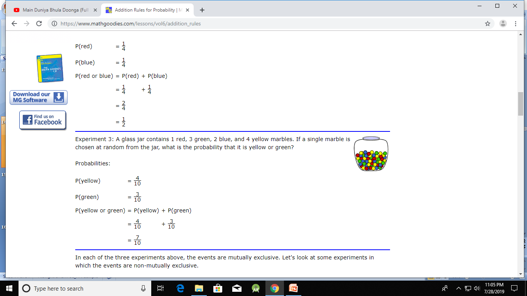
Addition Rule

Slide 27
Multiplication Rule
If A and B are two INDEPENDENT events, then
P(A and B) = P(A) * P(B).
If A and B are two Dependent Events, then
P(A and B) = P(A)P(B|A) = P(B)P(A|B),

Slide 28
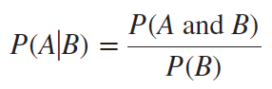
Conditional Probability and the Multiplication Rule (slide 1 of 2)
A formal way to revise probabilities on the basis of new information is to use conditional probabilities.
Let A and B be any events with probabilities P(A) and P(B). If you are told that B has occurred, then the probability of A might change.
The new probability of A is called the conditional probability of A given B, or P(A|B).
It can be calculated with the following formula:

Slide 29
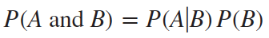
Conditional Probability and the Multiplication Rule (slide 2 of 2)
The numerator in this formula is the probability that both A and B occur. This probability must be known to find P(A|B).
However, in some applications, P(A|B) and P(B) are known. Then you can multiply both sides of the equation by P(B) to obtain the multiplication rule for P(A and B):

Slide 30
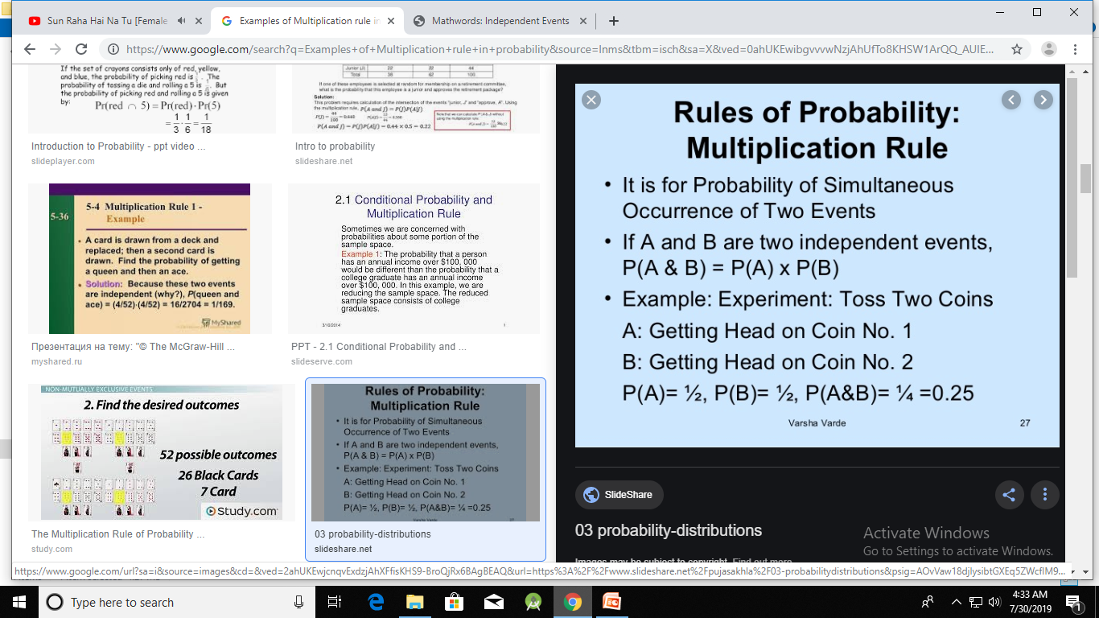
Multiplication Rule

Slide 31
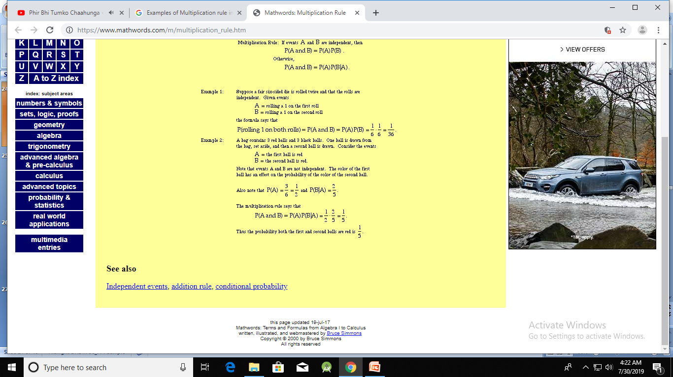
Multiplication Rule

Slide 32
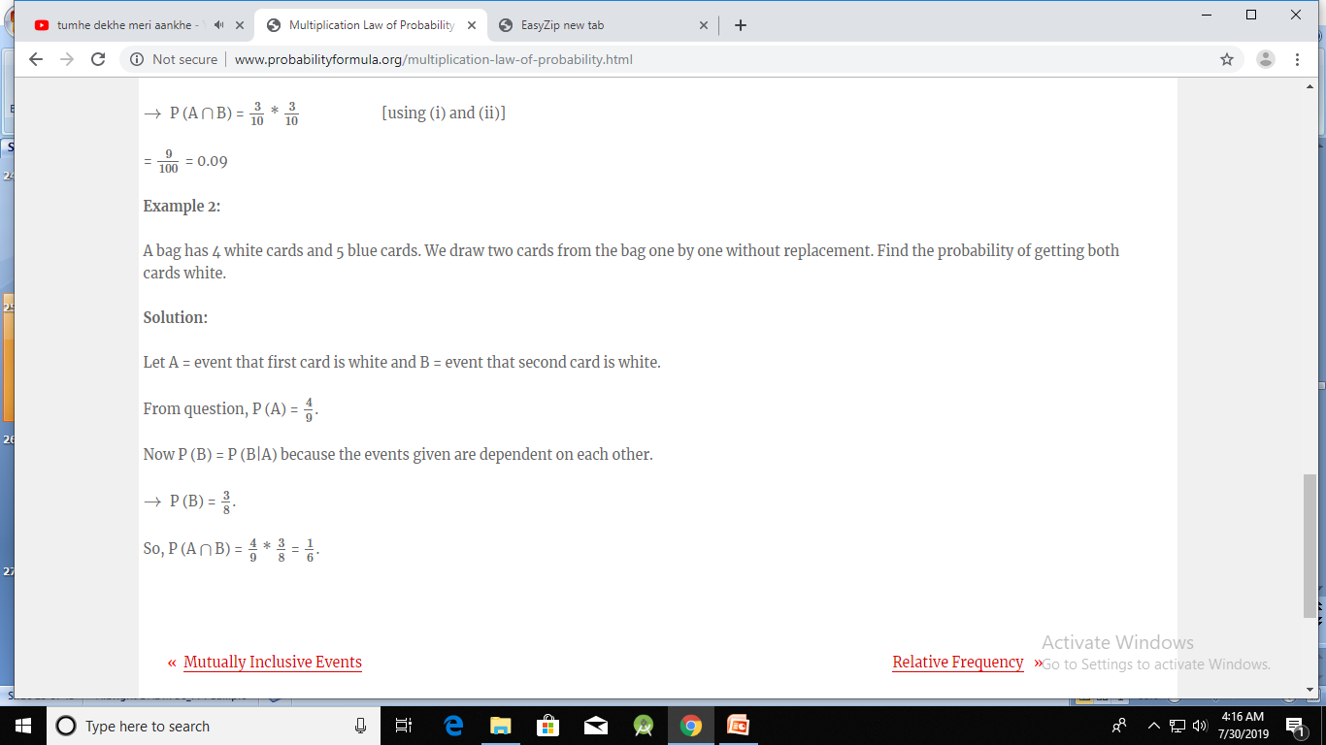
Multiplication Rule

Slide 33
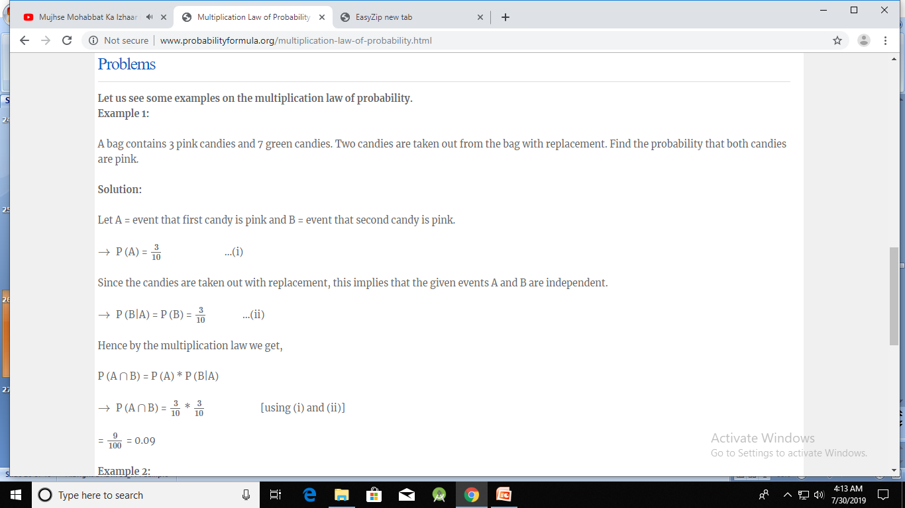
Multiplication Rule

Slide 34
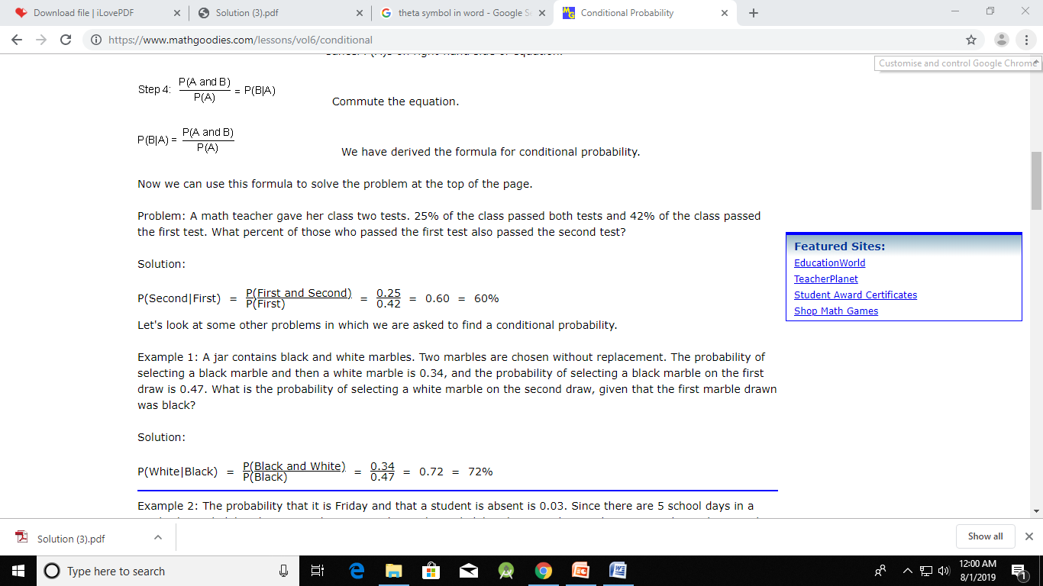
Conditional Probability and the Multiplication Rule

Slide 35
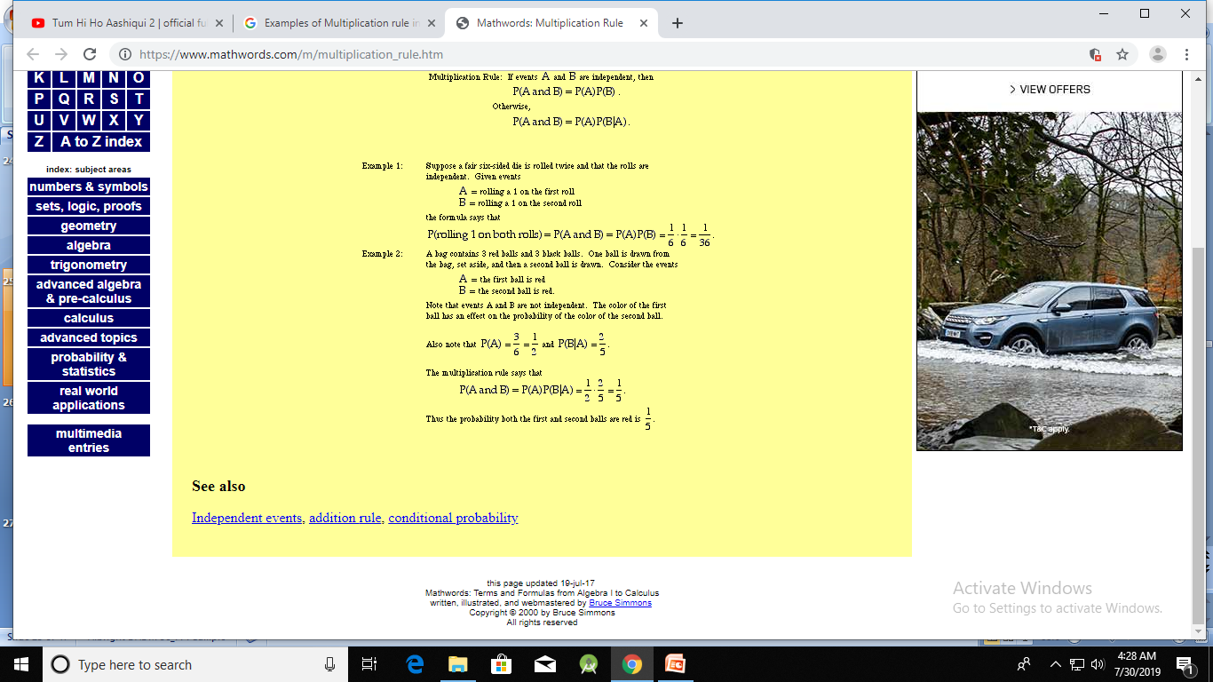
Multiplication Rule

Slide 36
Example 4. : Assessing Uncertainty at Bender Company (slide 1 of 2)
Objective: To apply probability rules to calculate the probability that Bender will meet its end-of-July deadline, given the information it has at the beginning of July.
Solution: Let A be the event that Bender meets its end-of-July deadline, and let B be the event that Bender receives the materials it needs from its supplier by the middle of July.
Bender estimates that the chances of getting the materials on time are 2 out of 3, so that P(B) = 2/3.
Bender estimates that if it receives the required materials on time, the chances of meeting the deadline are 3 out of 4, so that P(A|B) = 3/4.
Bender estimates that the chances of meeting the deadline are 1 out of 5 if the materials do not arrive on time, so that P(A|B) = 1/5.

Slide 37
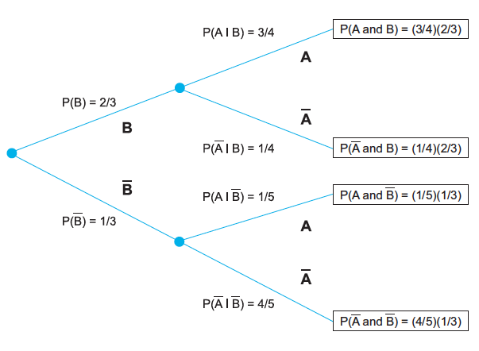
Example 4.1: Assessing Uncertainty at Bender Company (slide 2 of 2)
The uncertain situation is depicted graphically in the form of a probability tree.
The addition rule for mutually exclusive events implies that

Slide 38
Probabilistic Independence
There are situations where the probabilities P(A), P(A|B), and P(A|B) are equal. In this case, A and B are probabilistic independent events.
This does not mean that they are mutually exclusive.
Rather, it means that knowledge of one event is of no value when assessing the probability of the other.
When two events are probabilistically independent, the multiplication rule simplifies to:
To tell whether events are probabilistically independent, you typically need empirical data.

Slide 39
Equally Likely Events
In many situations, outcomes are equally likely (e.g., flipping coins, throwing dice, etc.).
Many probabilities, particularly in games of chance, can be calculated by using an equally likely argument.
However, many other probabilities, especially those in business situations, cannot be calculated by equally likely arguments, simply because the possible outcomes are not equally likely.

Slide 40
Subjective vs. Objective Probabilities
Objective probabilities are those that can be estimated from long-run proportions.
The relative frequency of an event is the proportion of times the event occurs out of the number of times the random experiment is run.
A relative frequency can be recorded as a proportion or a percentage.
A famous result called the law of large numbers states that this relative frequency, in the long run, will get closer and closer to the “true” probability of an event.
However, many business situations cannot be repeated under identical conditions, so you must use subjective probabilities in these cases.
A subjective probability is one person’s assessment of the likelihood that a certain event will occur.

Slide 41
Probability Distribution of a Single Random Variable (slide 1 of 3)
A discrete random variable has only a finite number of possible values.
A continuous random variable has a continuum of possible values.
Usually a discrete distribution results from a count, whereas a continuous distribution results from a measurement.
This distinction between counts and measurements is not always clear-cut.
Mathematically, there is an important difference between discrete and continuous probability distributions.
Specifically, a proper treatment of continuous distributions requires calculus.

Slide 42
Probability Distribution of a Single Random Variable (slide 2 of 3)
The essential properties of a discrete random variable and its associated probability distribution are quite simple.
To specify the probability distribution of X, we need to specify its possible values and their probabilities.
We assume that there are k possible values, denoted v₁, v₂, …, v_{k}.
The probability of a typical value v_{i} is denoted in one of two ways, either P(X = v_{i}) or p(v_{i}).
Probability distributions must satisfy two criteria:
The probabilities must be nonnegative.
They must sum to 1.

Slide 43
Probability Distribution of a Single Random Variable (slide 3 of 3)
A cumulative probability is the probability that the random variable is less than or equal to some particular value.
Assume that 10, 20, 30, and 40 are the possible values of a random variable X, with corresponding probabilities 0.15, 0.25, 0.35, and 0.25.
From the addition rule, the cumulative probability P(X≤30) can be calculated as:

Slide 44
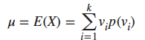
Summary Measures of a Probability Distribution (slide 1 of 2)
The mean, often denoted μ, is a weighted sum of the possible values, weighted by their probabilities:
It is also called the expected value of X and denoted E(X).
To measure the variability in a distribution, we calculate its variance or standard deviation.
The variance, denoted by σ² or Var(X), is a weighted sum of the squared deviations of the possible values from the mean, where the weights are again the probabilities.

Slide 45
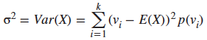
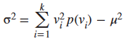
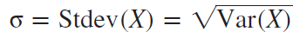
Summary Measures of a Probability Distribution (slide 2 of 2)
Variance of a probability distribution, σ²:
Variance (computing formula):
A more natural measure of variability is the standard deviation, denoted by σ or Stdev(X). It is the square root of the variance:

Slide 46
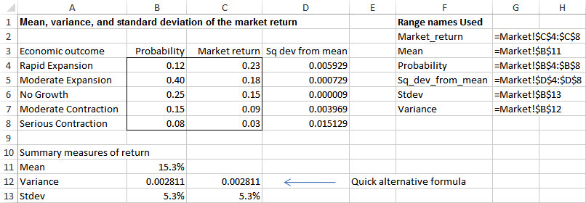
Example 4.2: Market Return.xlsx (slide 1 of 2)
Objective: To compute the mean, variance, and standard deviation of the probability distribution of the market return for the coming year.
Solution: Market returns for five economic scenarios are estimated at 23%, 18%, 15%, 9%, and 3%. The probabilities of these outcomes are estimated at 0.12, 0.40, 0.25, 0.15, and 0.08.

Slide 47
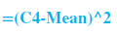
Example 4.2: Market Return.xlsx (slide 2 of 2)
Procedure for Calculating the Summary Measures:
1. Calculate the mean return in cell B11 with the formula:
2. To get ready to compute the variance, calculate the squared deviations from the mean by entering this formula in cell D4:
and copy it down through cell D8.
3. Calculate the variance of the market return in cell B12 with the formula:
OR skip Step 2, and use this simplified formula for variance:
4. Calculate the standard deviation of the market return in cell B13 with the formula:

Slide 48
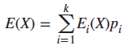
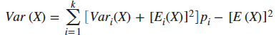
Conditional Mean and Variance
There are many situations where the mean and variance of a random variable depend on some external event.
In this case, you can condition on the outcome of the external event to find the overall mean and variance (or standard deviation) of the random variable.
Conditional mean formula:
Conditional variance formula:
All calculations can be done easily in Excel®.
See the file Stock Price and Economy.xlsx for details.

Slide 49
Introduction to Simulation (slide 1 of 2)
Simulation is an extremely useful tool that can be used to incorporate uncertainty explicitly into spreadsheet models.
A simulation model is the same as a regular spreadsheet model except that some cells contain random quantities.
Each time the spreadsheet recalculates, new values of the random quantities are generated, and these typically lead to different bottom-line results.
The key to simulating random variables is Excel’s RAND function, which generates a random number between 0 and 1.
It has no arguments, so it is always entered:

Slide 50
Introduction to Simulation (slide 2 of 2)
Random numbers generated with Excel’s RAND function are said to be uniformly distributed between 0 and 1 because all decimal values between 0 and 1 are equally likely.
These uniformly distributed random numbers can then be used to generate numbers from any discrete distribution.
This procedure is accomplished most easily in Excel through the use of a lookup table—by applying the VLOOKUP function.

Slide 51
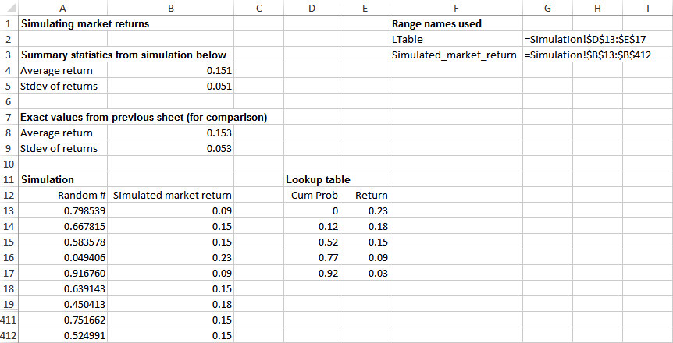
Simulation of Market Returns

Slide 52
Procedure for Generating Random Market Returns in Excel (slide 1 of 2)
1. Copy the possible returns to the range E13:E17. Then enter the cumulative probabilities next to them in the range D13:D17. To do this, enter the value 0 in cell D13. Then enter the formula:
in cell D14 and copy it down through cell D17. The table in the range D13:E17 becomes the lookup range (LTable).
2. Enter random numbers in the range A13:A412. To do this, select the range, then type the formula:
and press Ctrl + Enter.

Slide 53
Procedure for Generating Random Market Returns in Excel (slide 2 of 2)
3. Generate the random market returns by referring the random numbers in column A to the lookup table. Enter the formula:
in cell B13 and copy it down through cell B412.
4. Summarize the 400 market returns by entering the formulas:
in cells B4 and B5.

